Slide 1
A cross-platform solution for software plagiarism detection
Under the guidance of:
Prof. Ashwini M Joshi
Presented By:
Deepika M M
1PI14IS014

Slide 2
Introduction
The issue of plagiarism is a much discussed topic in the academic environment.
The software development process involves nowadays analysing numerous sources of inspiration.
Any technology should be very well documented and is very likely to be provided with some code snippets that demonstrate the basic usage principles.

Slide 3
Introduction
Students having access to numerous sources of inspiration(whether they are official or produced by other programmers) broadens the horizons of copy and this is a very positive aspect.
The downside of being able to access such vast areas of starting points is that inspiration can easily become plagiarism.

Slide 4
Introduction
It is imperative to draw a line between the coders that possess a certain piece of code claiming they put their own effort into producing it and the rightful creators of that specific software application.
Originality and code proprietary imprints needs to be highly valued in the software development process.

Slide 5
Code Originality Versus Code Plagiarism
source code should meet the following requests in order to be considered original when compared to its competitors: -
the names used for the software entities (constants, variables, functions, methods, classes, packages, etc.) should be as unique as possible.
the algorithmic solution has to have as few common points as possible; even though the concept might be similar, the actual implementation should differ very much from one programmer to another.

Slide 6
Code Originality Versus CodePlagiarism
A code file can manifest the following content types: -
1) comments; the header comments usually depict the code’s owner, the date the program was created and the main ideas about the tasks the code is able to resolve; the body comments inserted inside the code indicate the purpose of the nearby code.
2) actual code; in this category can be included the prerequisites used by the code (external libraries or files actual code; in this category can be included the prerequisites used by the code (external libraries or files .

Slide 7
Code Originality Versus CodePlagiarism
A code plagiarist tries to put his own marks on others code in order to prove he is the actual owner of the code. The main techniques used for accomplishing this are mentioned below.
T1. The comments can be modified and inserted in various places.
T2. The names of the software entities can be modified; its very easy to modify the names of the variables, functions, classes, etc.
T3. Different character or line spacing and altered indentation may also produce false negatives since the similarity chains are divided by this technique.
T4. The code modularity can be altered.

Slide 8
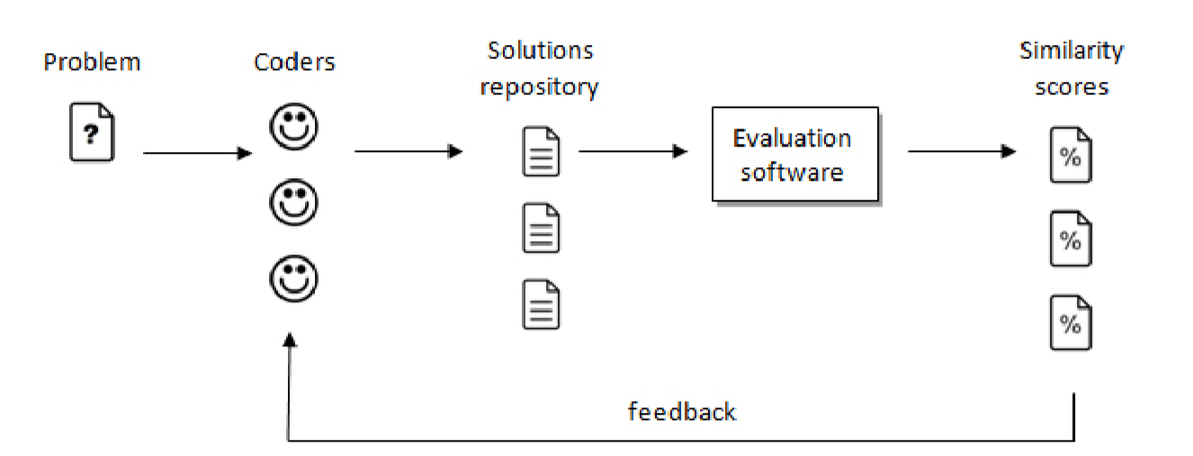
THE PROPOSED SOLUTION
The evaluation software’s role in the source code producing data flow

Slide 9
Input data preprocessing
Step 1. All the language dependent comments are eliminated by the code analyser.
Step 2. All the white space characters bigger than 1 blank are eliminated.
Step 3. All the block code delimiters are taken out.
Step 4. All the ; “ ” and ‘ ’ characters are suppressed.

Slide 10
Source codes parsing and vectorial representation
The parsing phase will emphasize the specificity manifested by the source codes as opposed to regular plain text files and a vectorial representation of the source file is created.
A first vector (v1) is populated, on each position having each language specific token and the number of its occurrences.
The second vector contains all the language tokens (v2), extracted from the source code, in the order of their appearance.
The third vector will store solely the language keywords (v3), in their appearance order. Another vector will contain solely the language operators (v4), in their appearance order.

Slide 11
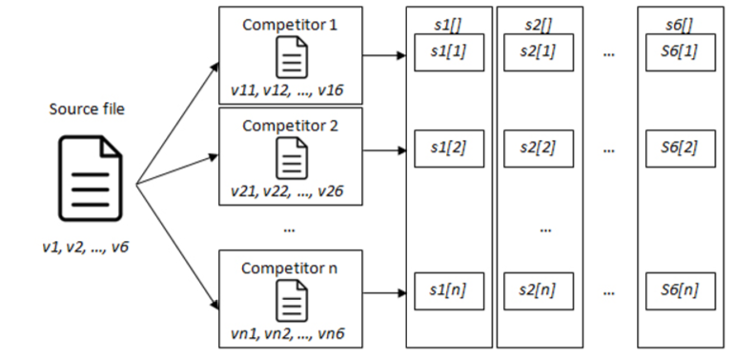
Vectorial scoring

Slide 12
Vectorial scoring
Scores 1 (s1[]), one-dimensional array. The associated counters of each item in v1 are matched against the corresponding values in v11…v1n.The values of s1 are initially equalized with the sum of all the counters from v1 and are decreased with the difference between the corresponding values found in v11…v1n.
Scores2 (s2[]), one-dimensional array. The values associated to each item located in v2 are compared to the values inv21…v2n. The values froms2 are initially 0 and are increased with the length of each matched sequence of items.

Slide 13
Vectorial scoring
Scores 3(s3[]) and Scores 4 (s4[]) are computed in the same manner as s2, only that they consider the vectors v3 and v4.
Score 5 (s5[]) and Score 6 (s6[]) have their values starting at 0 and are increased each time any single item from v5, respectively v6 is to be found in its competitors s51…s5n, respectively s61…s6n.

Slide 14
Scores reporting and interpretation
Considering the values obtained in the scoring arrays s1…s6, a final set of scores S[] will be computed for each source file.
On each position of the one-dimensional array S will be inserted the overall score obtained by weighted summing the individual scores s1…s6.
Each weight wk, k∈[1, 6] is a sub unitary value and denotes the importance in the final result of the associated vector. Summation (wk)=1
The weights ordered from the greatest value (importance) to the lowest one have the following positions: w2, w3,w4,w5,w6 and w1.
S[j]=summation Sj[k] *wk , j ∈[0,n-1] (2) The overall similarity measure of each file will be obtained by calculating the average value of the values stored in the S[] array.

Slide 15
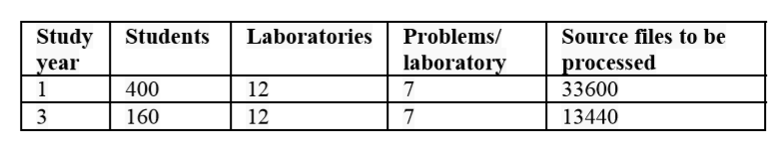
Obtained Results

Slide 16
Conclusions and Future Development
Planning to extend this application by including specific code compilers for each supported programming language.
This will give an automatic feedback about the correctness of the code.

Slide 17
THANK YOU

